Slide 1
The text provides an overview of various South American lizard species, including their unique characteristics, habitats, and ecological importance.

Slide 2
South America is home to a diverse range of lizard families, each with its unique characteristics and adaptations to the various habitats found across the continent. This study focuses on three remarkable lizard species the Green Iguana (Iguana iguana), the Caiman Lizard (Dracaena guianensis), and the Tepui Lizard (Pristidactylus urichi) highlighting their unique characteristics, habitats, and ecological significance. Additionally, we delve into the threats these lizards face and examine the conservation efforts in place to protect these captivating reptiles and ensure the preservation of their essential roles within South American ecosystems. Through this exploration, we hope to gain a deeper understanding of the importance of these reptilian inhabitants, encouraging further research and conservation initiatives to safeguard their future and the biodiversity they contribute to the magnificent continent of South America.
South America is home to a diverse range of lizard species, each with its unique characteristics and adaptations to the various habitats found across the continent. This research explores the fascinating world of South American lizards, highlighting the unique characteristics, habitats, and ecological significance of three remarkable species.

Slide 3
The diverse lizard families of South America include the Sphaerodactylidae, Dactyloidae, Leiosauridae, Polychrotidae, and many others.
Each family is characterized by unique physical and behavioral traits, such as small size, colorchanging ability, and perching behavior, that allow them to thrive in their respective habitats.
Some notable species include the Green Iguana (Iguana iguana), which is known for its vibrant green coloration and impressive size, and the Redbellied Water Snake (Nerodia rhodomelane), which is distinguished by its red belly and preference for aquatic habitats.
The rich biodiversity of South America's lizards contributes to the functioning of their respective ecosystems and highlights the importance of conserving their habitats and populations.
South America is home to an incredible diversity of lizard species, with over 1,000 species identified to date. This region boasts a remarkable variety of lizard families, each with its unique characteristics and ecological roles. This essay will provide a brief overview of some of the most notable lizard families found in South America, including the Green Iguana (Iguana iguana), a large and vibrant species that plays a crucial role in its ecosystems.

Slide 4
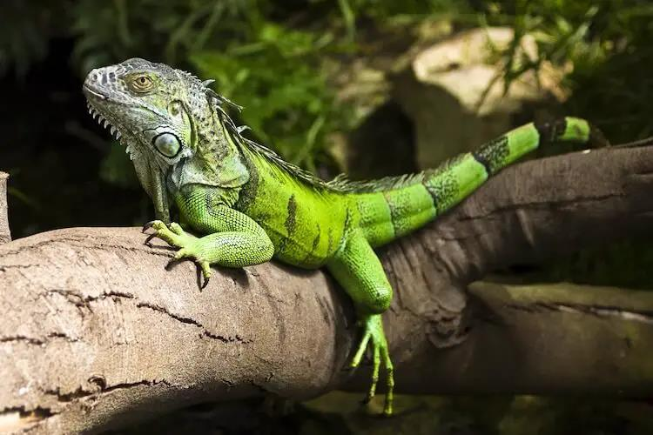

Slide 5
The Caiman Lizard (Dracaena guianensis) is a captivating reptile native to the tropical regions of South America, particularly found in the Amazon Basin and its surrounding areas. The Tepui Lizard (Pristidactylus urichi) is a captivating and unique reptile inhabiting the Tepui plateaus of South America.
The Caiman Lizard and the Tepui Lizard are two captivating reptile species found in South America. Both possess unique adaptations that allow them to thrive in their respective environments. However, they face threats such as habitat destruction and illegal trade, emphasizing the need for conservation efforts to preserve them and their critical roles in their respective ecosystems.

Slide 6
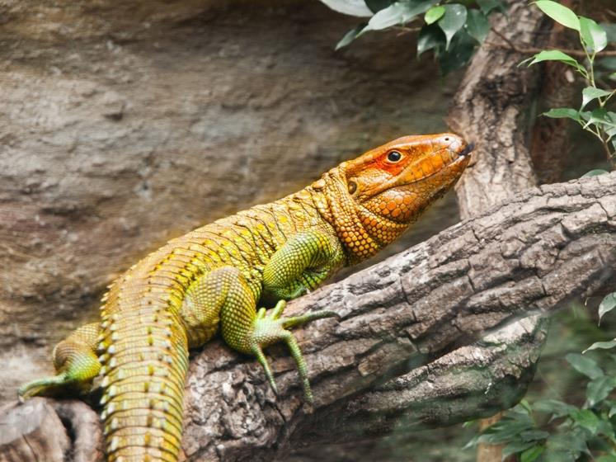

Slide 7
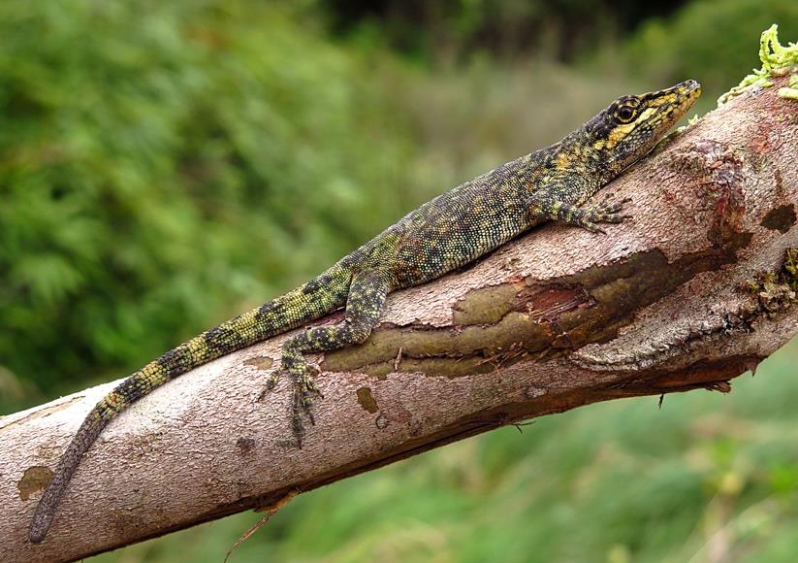

Slide 8
South America is home to an impressive diversity of lizard species, ranging from the Green Iguana and Caiman Lizard to the Tepui Lizard.
These captivating reptiles occupy a variety of habitats, from tropical forests to aquatic environments, and serve crucial ecological roles in their respective ecosystems.
However, they face various threats, including habitat loss, illegal pet trade, pollution, and climate change, which impact their survival and wellbeing.
To conserve these species, it is essential to establish protected areas and reserves, combat illegal pet trade, minimize pollution, and conduct research on the effects of climate change.
Community involvement, education, and collaboration with local stakeholders are also vital components of successful conservation initiatives.
By understanding the unique characteristics and ecological roles of South American lizards, we can work to protect their populations and the biodiversity they contribute to the continent's ecosystems.
South American lizards, including the Green Iguana, Caiman Lizard, and Tepui Lizard, are threatened by habitat loss, illegal pet trade, and other factors. These captivating creatures play essential ecological roles in their respective habitats, contributing significantly to the overall balance and health of their ecosystems.

Slide 9
South American lizards are facing numerous threats, such as habitat loss, climate change, and illegal trade, which necessitate urgent conservation efforts. Through responsible research, education, and community involvement, we can work towards protecting the habitats and promoting the welfare of these reptilian inhabitants.
South America is home to an impressive diversity of lizards, ranging from small geckolike creatures to large monitor lizards. These reptiles play vital roles in their respective ecosystems, maintaining the delicate balance of nature. However, they face numerous threats, such as habitat loss, climate change, and illegal trade, which necessitate urgent conservation efforts.

